Slide 1
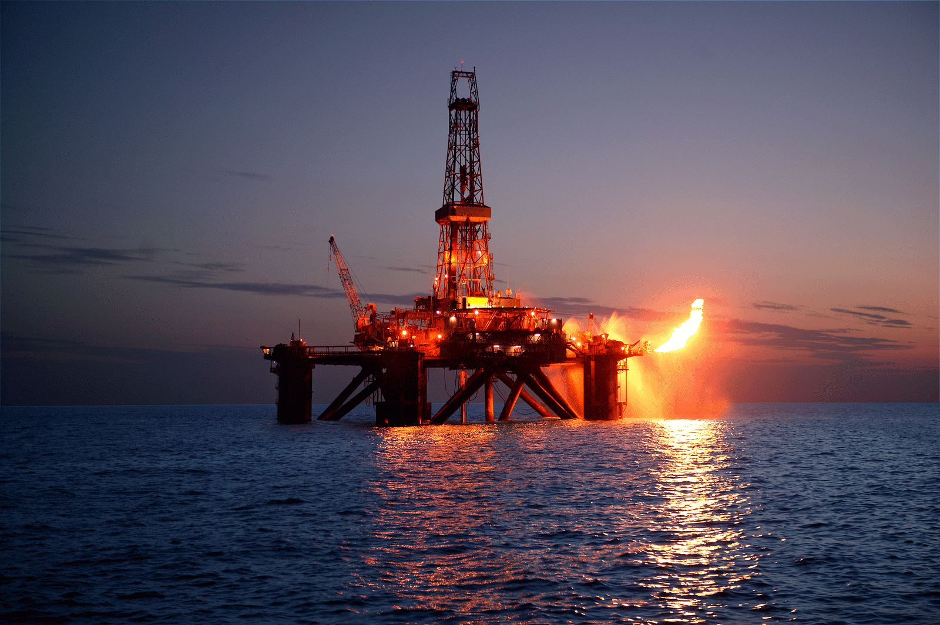
WELL CONTROL
AHMAD HAMID
15.NOV .2015

Slide 2
Why Well Control is needed?
It is very well known that the blowouts are costing the oil industry millions of dollars each year, however, if we define the blowout as an uncontrolled or undefeated kick, this leads us to say that, kicks practically costs the industry not less than that, since the biggest fire is seated by a small spark.
The most critical concern in this approach is the human factor in the case of a blowout before it comes to capital losses it could cause loss of lives, and then the losses can’t be measured since the human life is un-measurable, especially for the family of the victims.
Blowout does not happen suddenly, it has a start and potentials, it should be noted that more than one member of the drilling crew did not perform his work properly. The causes of blow out have been ignored as well as the warning signs were not noticed on time. This leads us to refer again to human factor (errors or negligence).
To improve the awareness and minimize the errors, Well control Training Program should be set to sharpen the skill of the drilling crew and encourage them to react before the problem takes place.

Slide 3
Objective
It should be clearly understood by every oil and gas crew member that the objective is to drill or work over a well safely and to prevent the blowouts for the following reasons:
To save lives
To save equipment
To save oil and gas
To save the environment

Slide 4
Abbreviations Used in this Document
bbl = Barrels (US)
bbl/min = Barrels (US) per minute
BHP = Bottom Hole Pressure
BOP = Blowout Preventer
ft = Feet
ft/min = Feet per minute
lb/bbl = Pounds per barrel
LOT = Leak-off Test
MAASP = Maximum Allowable Annular Surface Pressure
ppg = Pounds per gallon
psi = Pounds per square inch
psi/ft = Pounds per square inch per foot
psi/hr = Pounds per square inch per hour
TVD = True Vertical Depth
0.052 = Constant factor

Slide 5
Hydrostatic Pressure
Hydrostatic pressure is the pressure exerted by the weight of a column of fluid. The size and shape of the fluid column don’t affect the magnitude of this pressure. Hydrostatic pressure (HP) depends only on the density of the fluid and the height of the column of fluid.
HP=Mud Density (ppg)x 0.052 x TVD ft
Example :
Given Mud weight = 8.34 ppg, depth = 10,000'. Calculate hydrostatic pressure which is exerted by mud.
Solution HP =TVD . MW . 0.052
HP = 10,000 . 8.34 . 0.052 = 4337 psi

Slide 6
Pressure Gradient
Pressure gradient is defined as the pressure increment per unit foot of depth. Water, for example, will increase the hydrostatic pressure by 0.433 psi for every foot of hole.
HP = TVD . MW . 0.052
Pressure Gradient = MW . 0.052 (psi/ft)
Can be written HP = TVD . Pressure Gradient
Example 2: Given MW = 10.3 ppg, depth = 11000'
Find ? a) Pressure Gradient b) Hydrostatic Pressure
Solution
a) Pressure Gradient = 10.3 . 0.052 = 0.536 psi/ft
b) Hydrostatic Pressure = 11000' . 0.536 = 5892 psi

Slide 7
NISOC Formation Gradient
Fracture Pressure | Mud Pressure | Pore Pressure | Formation
0.680 | 0.450 | 0.433 | Aghajari
0.700 | 0.479 | 0.465 | Mishan
1.1 | 0.85-1.1 | 0.8-1.0 | Gachsaran
0.74 | 0.43-0.56 | 0.24-0.49 | Asmari
0.8 | 0.52-0.56 | 0.5-0.54 | Pabdeh
0.74 | 0.56 | 0.54 | Ilam & Sarvak

Slide 8
Bottom Hole Pressure
Bottom Hole Pressure is defined as the pressure exerted at the bottom of the hole. During drilling operations while drilling a well, pressure is imposed on the walls or at the bottom of the hole. Most of this pressure comes from the hydrostatic pressure of the mud column. However, the pressure required to pump the mud up the annulus also acting on the bottom of the hole.
PBHP= 0.052* MW (ppg)*TVD(ft)

Slide 9
Normal Formation Pressure(Balance)
Formation Pressure (FP) is the pressure contained inside the rock pore space. In the simplest case, the pressure is due to the hydrostatic pressure of formation fluid above the depth of interest. Salt water is a common formation fluid that weights 9 ppg. Therefore, the formation pressure gradient is 9 ppg . 0.052 = 0.465 psi/ft. By convention, a Formation Pressure (FP) gradient 0.465 is considered normal. The pressure information containing salt water is found by multiplying depth by 0.465. Again, as in all hydrostatic pressure calculations, the depth should be true vertical depth (TVD) for directional wells.
PFP = P HP

Slide 10
Abnormal Formation Pressure(Underbalance)
Frequently, a seal or barrier (Tectonically fault) interrupts the formation connection with the above formations. In this case, the fluid below the barrier must also support part of the rock weight from the above. Also, we know that rock is heavier than water, so formation pressure can exceed normal hydrostatic pressure.
P FP > P HP
Sub normal Formation Pressure(overbalance)
Some formations are sub normally pressured. This means that the pressure is less that of a column of salt water. This condition occurs in depleted production formations or in older formation that have large cavities or fractures. PFP < PHP

Slide 11
Fracture Pressure
Fracture Pressure is the amount of pressure a formation can withstand before it falls and splits. Excessive pressures, in the hole can cause formation fracture and loss of whole mud to the formation. Fluid first must penetrate the formation before fracturing can occur. This means that the pressure imposed on the formation must exceed the formation pressure. Then, the hole pressure must be greater than the strength of the rock

Slide 12
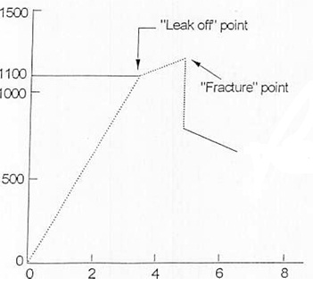
Fracturing Formation Below Shoe
The procedure is to drill some 30 feet below the casing shoe or until first permeable formation is drilled. Pull the bit into the casing, close BOP, and determine the pressure at which the formation takes fluid. Take great care to stop pumping immediately when it is observed that pressure verses volume trend changes. This established the "Leak-off point". This establishes the maximum allowable annular surface pressure with a certain mud weight in the hole.

Slide 13
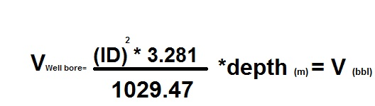
Well Capacity
The well capacity is the well bore volume of any liquid inside the Casing ,Tubing, Completion, Open hole and other …
How it is calculated as follows.
For example = count 1000m 7” liner with ID 6.180” ?
V well bore = (6.180*6.180)*3.281 / 1029.47 *1000(m)= 121 bbl
So 1000m/121 bbl =8.26m means that for pumping 1 bbl in 7” liner covering 8.26m

Slide 14

Annular Volume
The Annular Volume is the volume of mud between the sides of the well bore and the outside of the Drill String.
The annular volume can be divided into three sections:
1- Between the casing and drill pipe.
2- Between the open hole and the drill pipe.
3- Between the open hole and the drill collars.

Slide 15
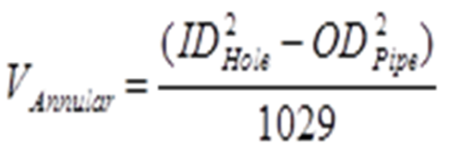
Example
8243 ft of 5" drill pipe, 19.50 Ibs/ft, inside 8 1/2" hole. Calculate Annular volume around the pipe.
Solution
From formula:
Annular Volume = (8.5­­² -5²)/1029= (72.25-25)/1029 = 0.0459 bbls/ft
Total Annular Volume around the OP = 0.0459 . 8243 = 378 bbls
The same method of calculations is applicable for the annular volume around the Drill Collars in the open hole.

Slide 16
Kick
A kick is unplanned flow of formation fluid into the wellbore. The fluid may be either liquid or gas. When the unplanned flow becomes uncontrolled and undefeated then it develops a BLOW OUT.
If hydrostatic pressure of the drilling fluid is not kept above the formation pressure in the rocks being drilled, the formation fluids enter the well. For example, the only cause for a well to kick is when the formation pressure is greater than bottom hole pressure

Slide 17
Causes of Induced Kicks
1-Not filling the hole properly
2-Gas cut mud
3-Swabbing
4-Surging
5-Mud weight too low
6-Drilling break not handled properly

Slide 18
Not Filling The Hole Properly
Improperly filling the hole during trips is another predominant cause of kicks. As the drill pipe is pulled out of the hole the mud level falls due to the fact that the drill pipe steel had displaced some amount of mud. With the pipe no longer in the hole, the mud must fill the spaces where the pipe had been. Therefore, the overall mud level decreases, and as a consequence, the hydrostatic pressure of the mud also decreases due to a shorter column or head.
Gas Cut Mud
Gas and saltwater contaminated mud will occasionally cause a kick although this occurrence is rare. The mud cutting is usually that which is obtained from the core volume cut by the bit and released into the mud system. As the gas is circulated to the surface, it may expand and reduce the overall hydrostatic pressure to a point sufficient to allow a kick to occur

Slide 19
Swabbing
Swab pressures are pressures created by pulling the drill string from the borehole. The swab pressure is a negative pressure and reduces the effective hydrostatic pressure through the hole. If this pressure reduction is large enough to lower the effective hydrostatic pressure to a value below the formation pressure, then a kick potential situation has been developed
Surging "Lost Of Circulation"
Surging is the opposite of swabbing. It occurs when the downward motion of the drill string is adding to wellbore pressure, rather than reducing it. However, both problems are brought on by failing to maintain the proper balance between hydrostatic and formation pressures. Surging can create fracturing, which can lead to a condition known as "lost circulation". Surging is created by running drill string into the hole too rapidly

Slide 20
Mud Weight Too Low
Insufficient mud weight is one of the predominant causes of kicks. In this case, a permeable zone was drilled while using a mud weight that exerted less pressure than the formation pressure within the pay zone. As a result of this pressure imbalance, fluids begin to flow into the wellbore and the kick occurs.
Drilling Break Not Handled Properly
Drilling break is a sharp increase in the bit penetration rate, it could be a serious cause of kick if not handled properly. It is recommended to drill up to 5' in the formation and to carry out flow check, if the well is flowing then a bottom up circulation should be perform. In case of exploration well drilling, if the drilling break occurs, it is recommended to circulate bottoms up after the flow check whether the well is flowing or not.

Slide 21
Warning Signs of Kicks
Flow Rate Increase
Pit Volume Increase
Flowing Well With Pumps Off
Pump Pressure Decrease and Pump Stroke Increase
String Weight Change
Drilling Break
Gas Cut Mud

Slide 22
Well Killing Method
All well killing method use a common principle
Maintain a minimum constant bottom hole pressure equal to or greater than the formation pressure while circulating out the formation influx to regain control of the well :
MW kill =Surface pressure psi/0.052*TVD ft +MW Original
1-Volumetric method
2-Lubricate and bleed
3-Bullhead

Slide 23
Volumetric method
The volumetric method is a non circulation well kill method and can be used only if the influx can migrate up.
Lubricate and bleed
The gas an associated casing pressure is bleed off and replace with fluid keeping the BHP constant.
Bullhead
The formation influx pumped back to reservoir .it is common well killing method can be use.

Slide 24
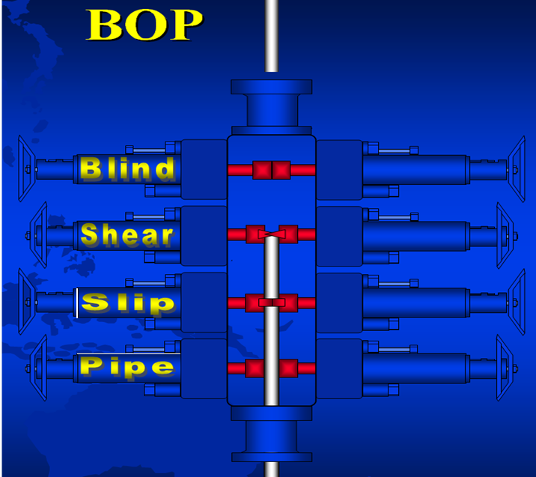

Slide 25
Function
Blind/Shear Assembly
Blind : operates the Blind Rams that have seals to isolate well bore fluids and contain pressure when there is no coiled tubing in the BOP.
Shear: the shear rams have cutter blades to cut through coiled tubing, wire line and cable.
Pipe/ Slip assembly
Pipe: Operates the Pipe Rams that seal around the coiled tubing to isolate well bore fluids and contain pressure.
Slip : Operates the Slip Rams that have slip inserts to grip the coiled tubing and support the weight of the tubing hanging below it (some of these are bidirectional and prevent the coiled tubing from moving upward).

Slide 26
Flange
There are many different flange standards to be found worldwide. To allow easy functionality and inter-changeability, these are designed to have standardized dimensions. Common world standards include ASA/ANSI/ASME (USA), PN/DIN (European), BS10 (British/Australian), and JIS/KS (Japanese/Korean).typically made from forged materials and have machined surfaces. B16.5 refers to nominal pipe sizes (NPS) from ½" to 24". B16.47 covers NPSs from 26" to 60". Each specification further delineates flanges into pressure classes. These pressure classes also have differing pressure and temperature ratings for different materials.
The flange faces are also made to standardized dimensions and are typically "flat face", "raised face", “tongue and groove ", or “ring joint" styles, although other obscure styles are possible.
Flange designs are available as “weld neck", "slip-on", "lap joint", "socket weld", threaded", and also "blind".

Slide 27
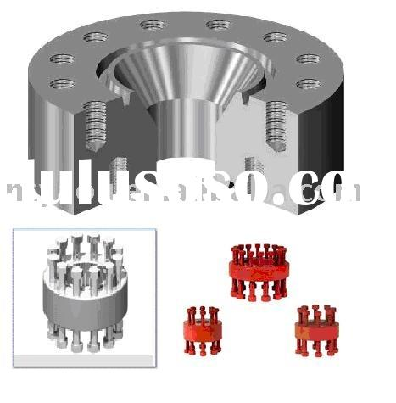
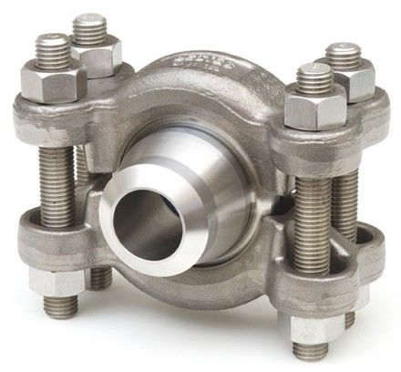
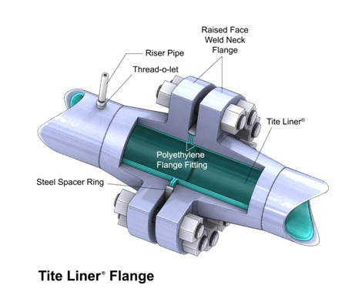
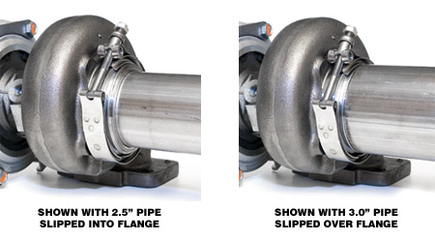
Flange
1-Stud Flange
2-Clamp Flange
3-API Flange

Slide 28
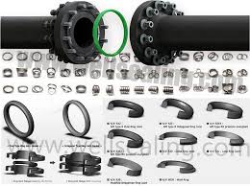
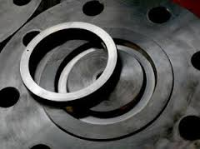
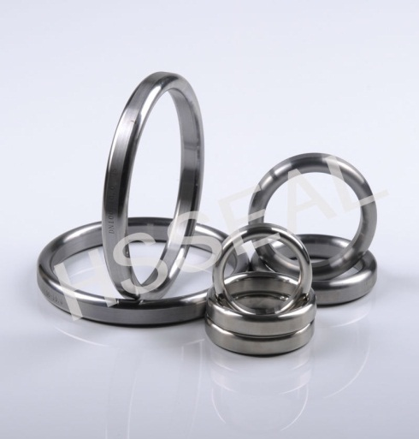
Gasket
A gasket is a mechanical seal which fills the space between two or more mating surfaces, generally to prevent leakage from or into the joined objects while under compression. Gaskets allow "less-than-perfect" mating surfaces on machine parts where they can fill irregularities.

Slide 29
Different gasket and flange size
Bolt QTY | Bolt size | Gasket | Flange size
8 | 5/8” | RX 23 | 2” 3000 psi
8 | 7/8” | RX 24 | 2” 5000 psi
8 | 3/4” | BX 152 | 2” 10000 psi
8 | 7/8” | RX 31 | 3” 3000 psi
8 | 1 1/8” | RX 35 | 3” 5000 psi
8 | 1” | BX 154 | 3” 10000 psi
8 | 1 ¼” | RX 39 | 4” 5000 psi
8 | 1 1/8” | BX 155 | 4” 10000 psi
12 | 1 1/8” | RX 45 | 6” 3000 psi
12 | 1 3/8” | RX 46 | 6” 5000 psi
12 | 1 ½” | BX 156 | 6” 10000 psi

Slide 30
Thank you

